Slide 1
3D Reconstruction System using NVIDIA Jetson Nano
Student: Yifan Jiang
Supervisor: Yong Yue

Slide 2
Content：
1. Introduction
2. Project Objectives
3. Project Budget and Schedule
4. Methodology
5. Experimental Results
6. Discussion
7. Future Works
8. Conclusion

Slide 3
1. Introduction
Computer vision advances
3D reconstruction
self-driving car
service robot
Previous research…
distance measurement with mobile device
monocular, wide-angle lens, 2D images
CNNs, DNNs and DRL, MATLAB
Key problem
combine image recognize and ranging
with binocular camera

Slide 4
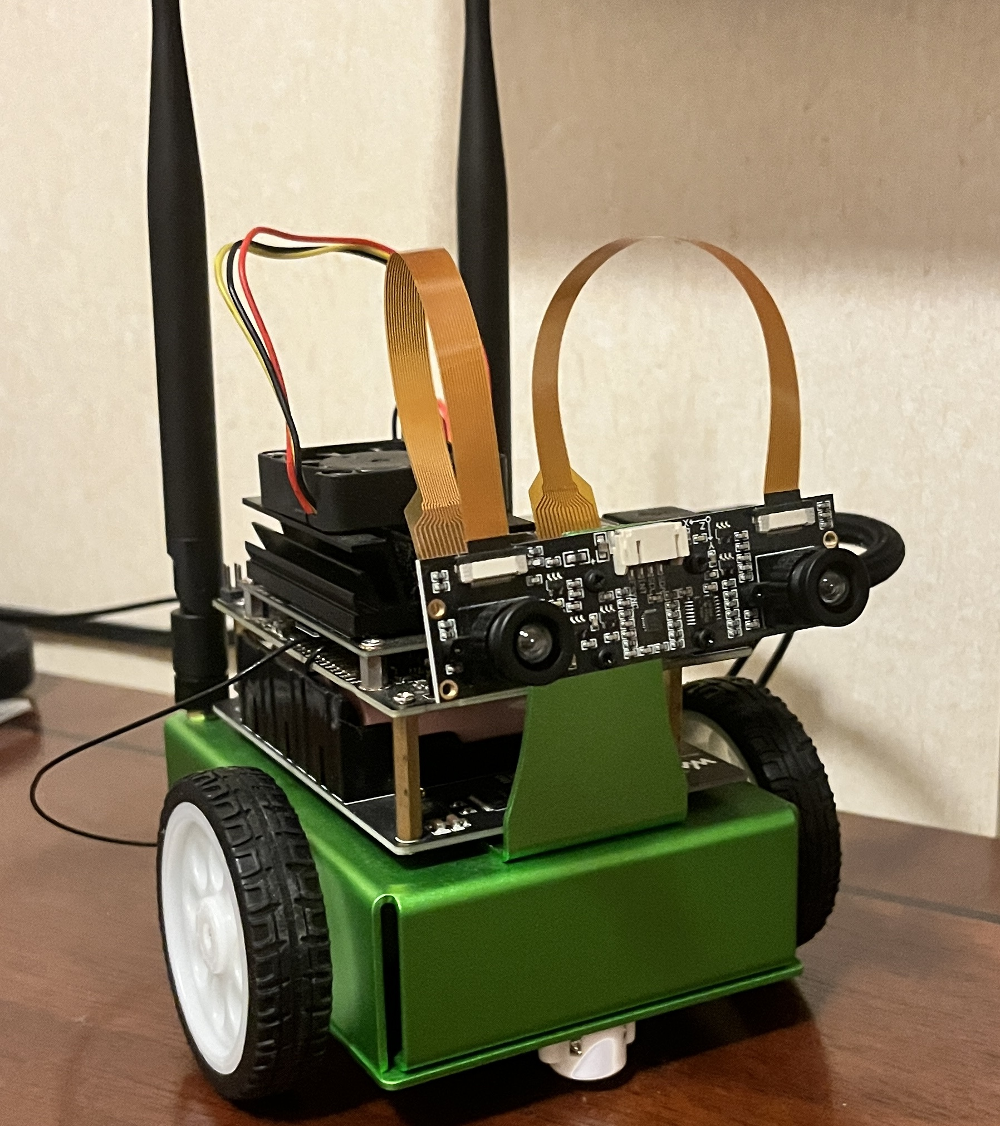
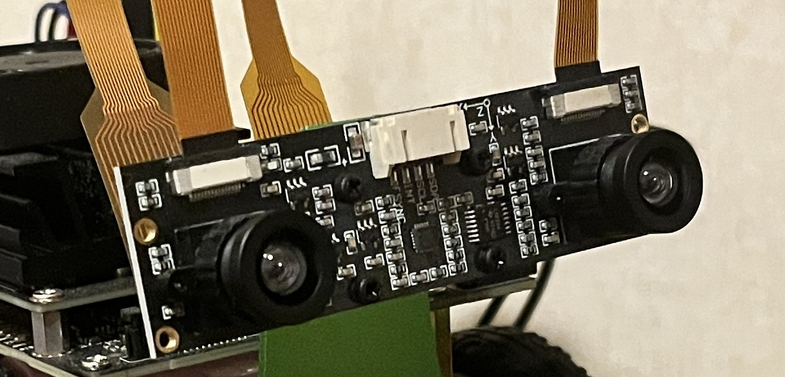
2. Project Objectives
Jetson Nano → 3D reconstruction system
1. Binocular camera， video detection
2. Semantic segmentation
3. Model training
4. Image recognition
5. Distance detection
6. Graphic interface

Slide 5
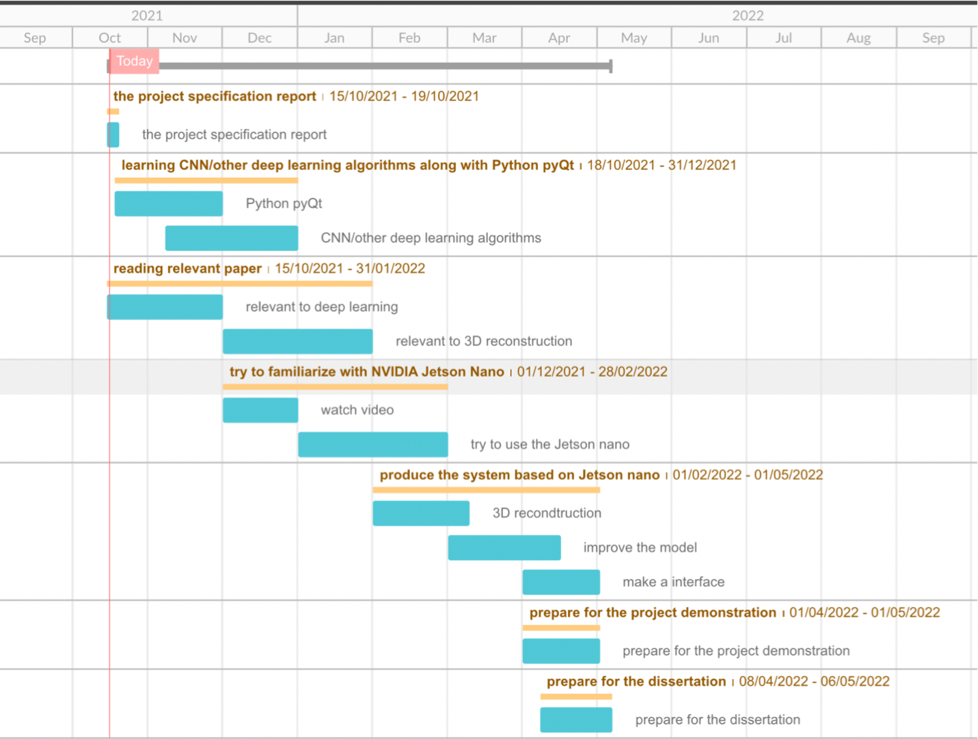
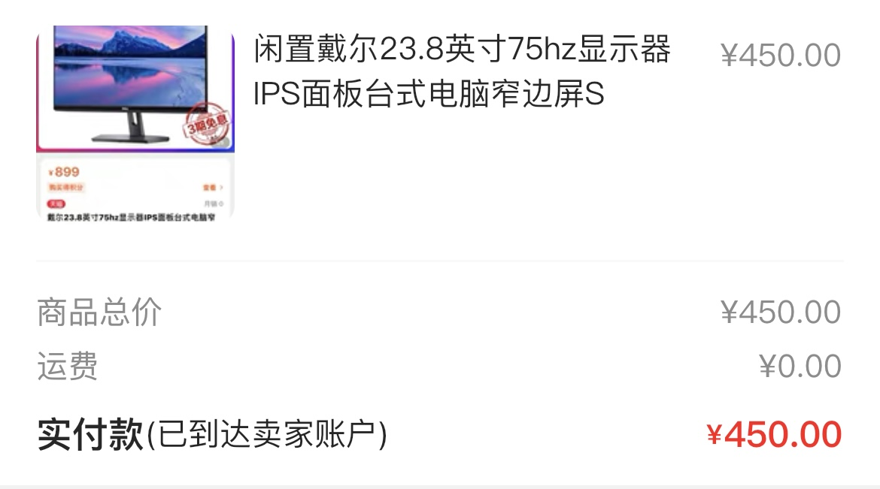
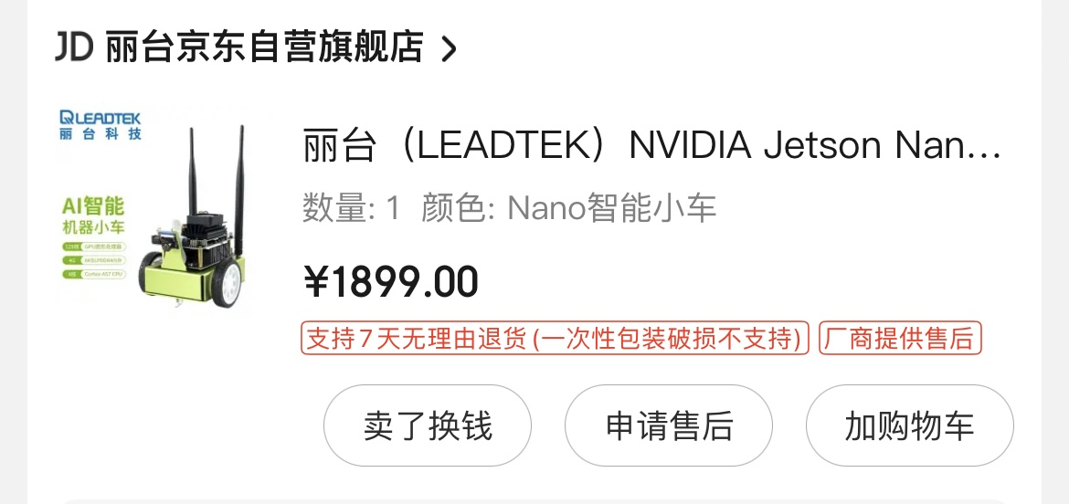
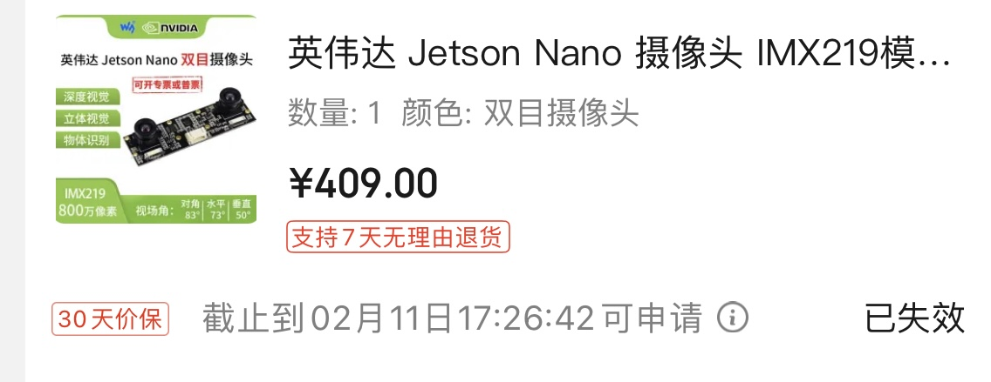
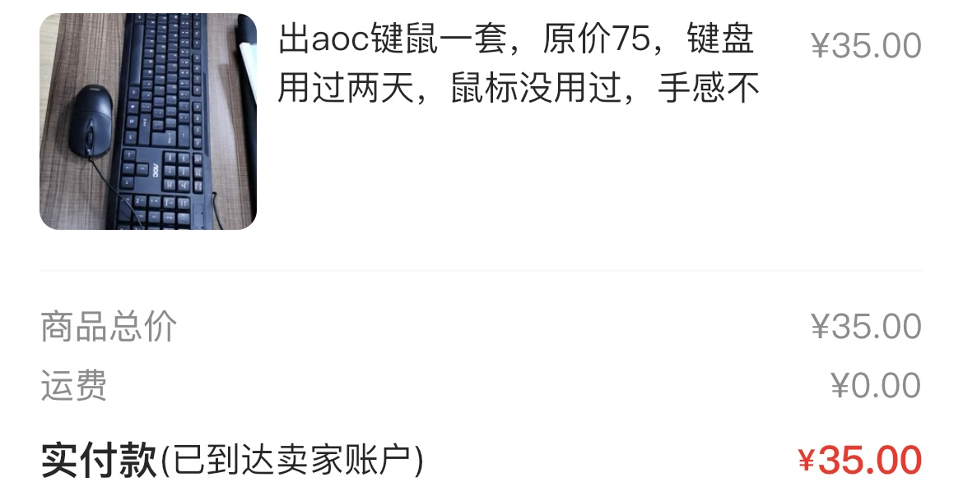
3. Project Budget and Schedule
Budget:
Binocular camera
Jetson nano
Jetson robot
Displayer
Keyboard
Mouse

Slide 6
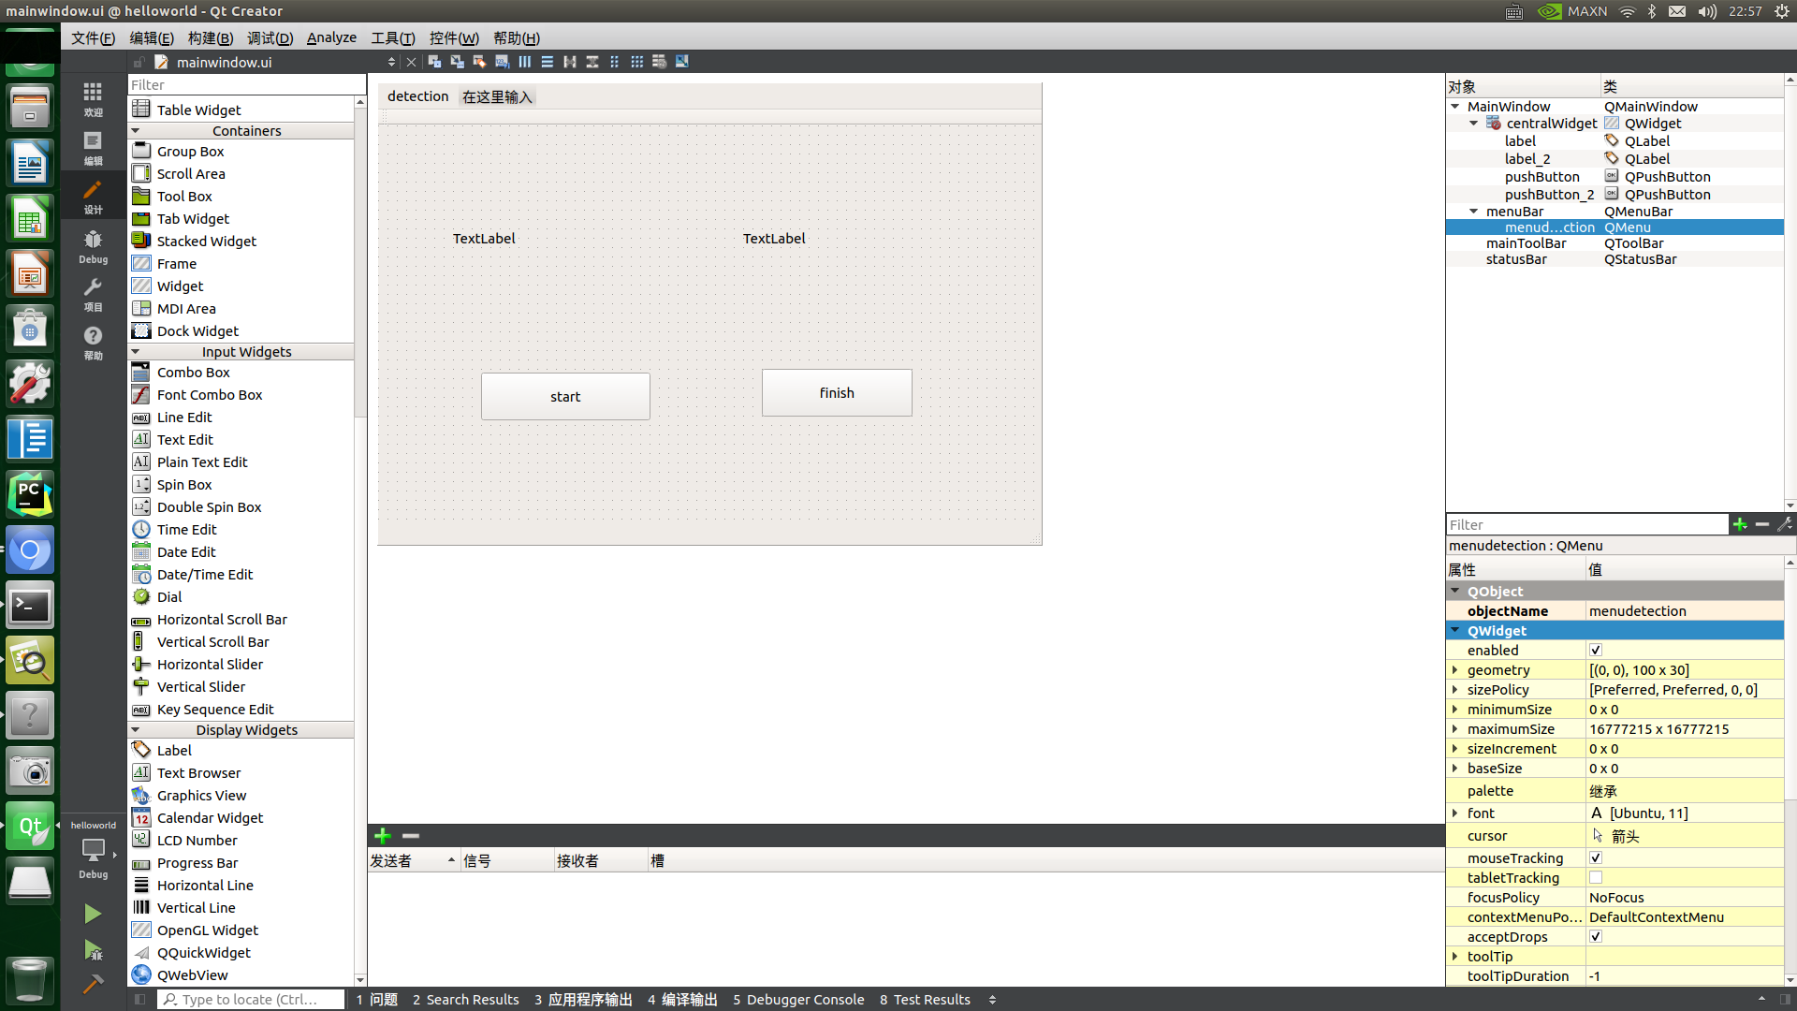
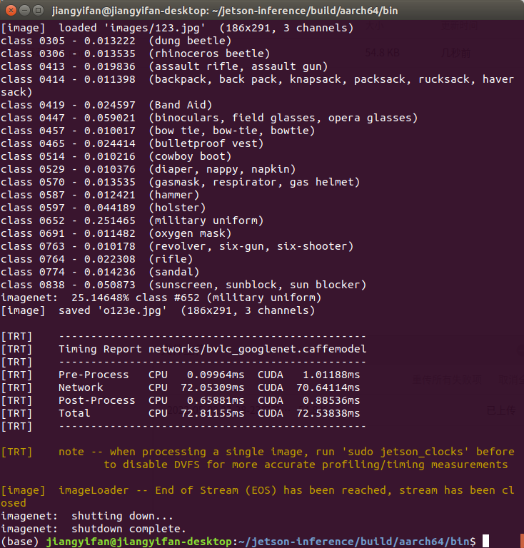
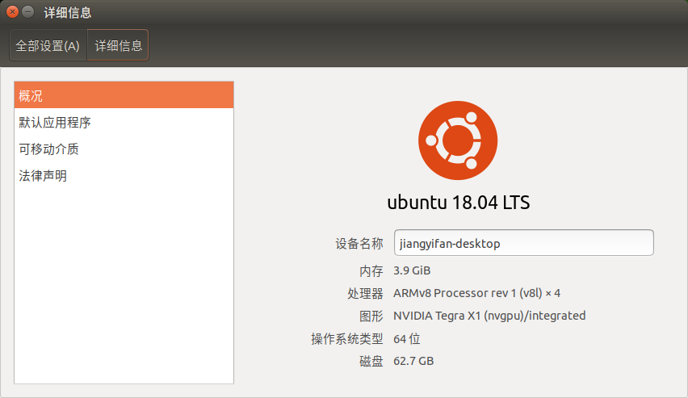
4. Methodology
System structure
Ubuntu 18.04 LTS arm64 architecture
CUDA 10.2, Python 3.6
Algorithm
Image Identification
Jetson- inference
DNN classification training
2. Ranging
orb-slam2 algorithm
Reconstruct the object and relevant environment
Implementation tool :
Qt creator

Slide 7
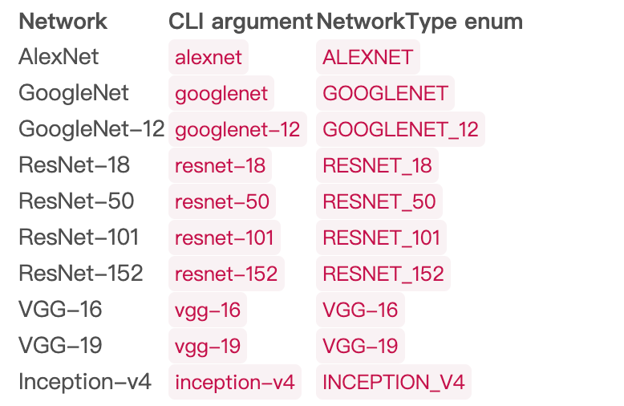
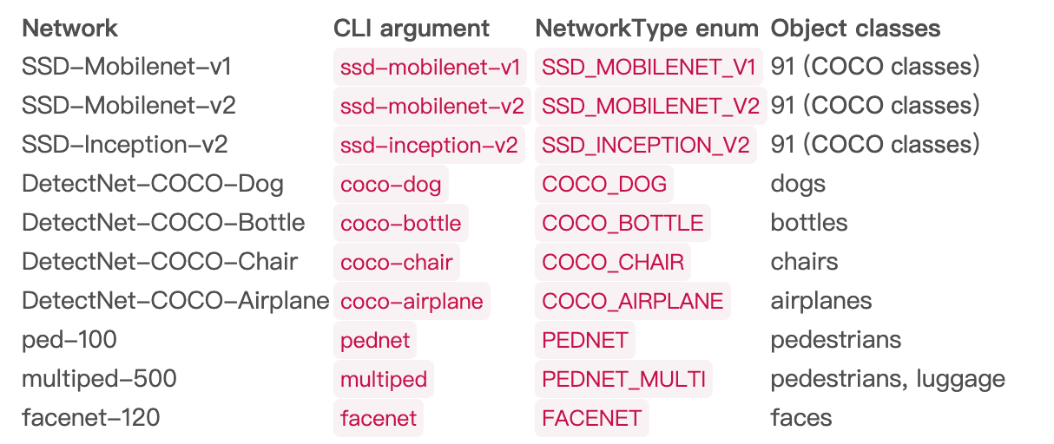
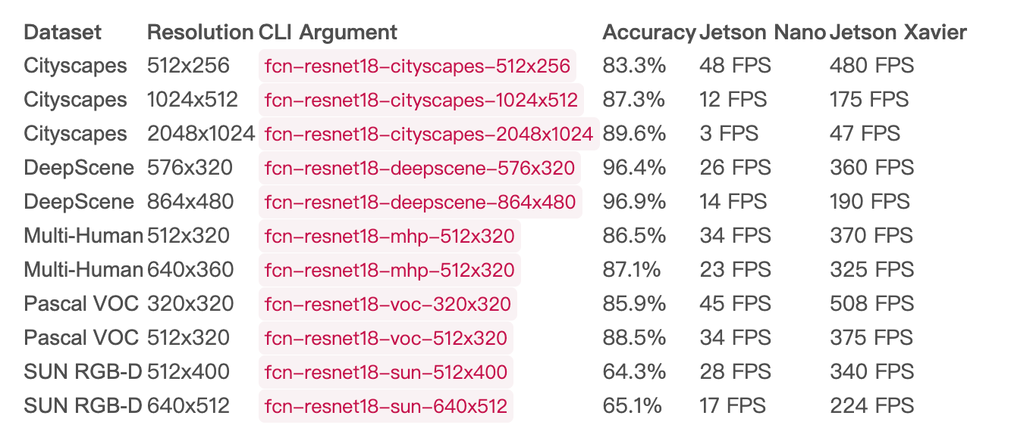
5. Experimental Results
Semantic Segmentation Preprocessing Model
import
FCN, Google Net etc.
training
Jetson-inference
Image recognition pretrained model
Object detection

Slide 8
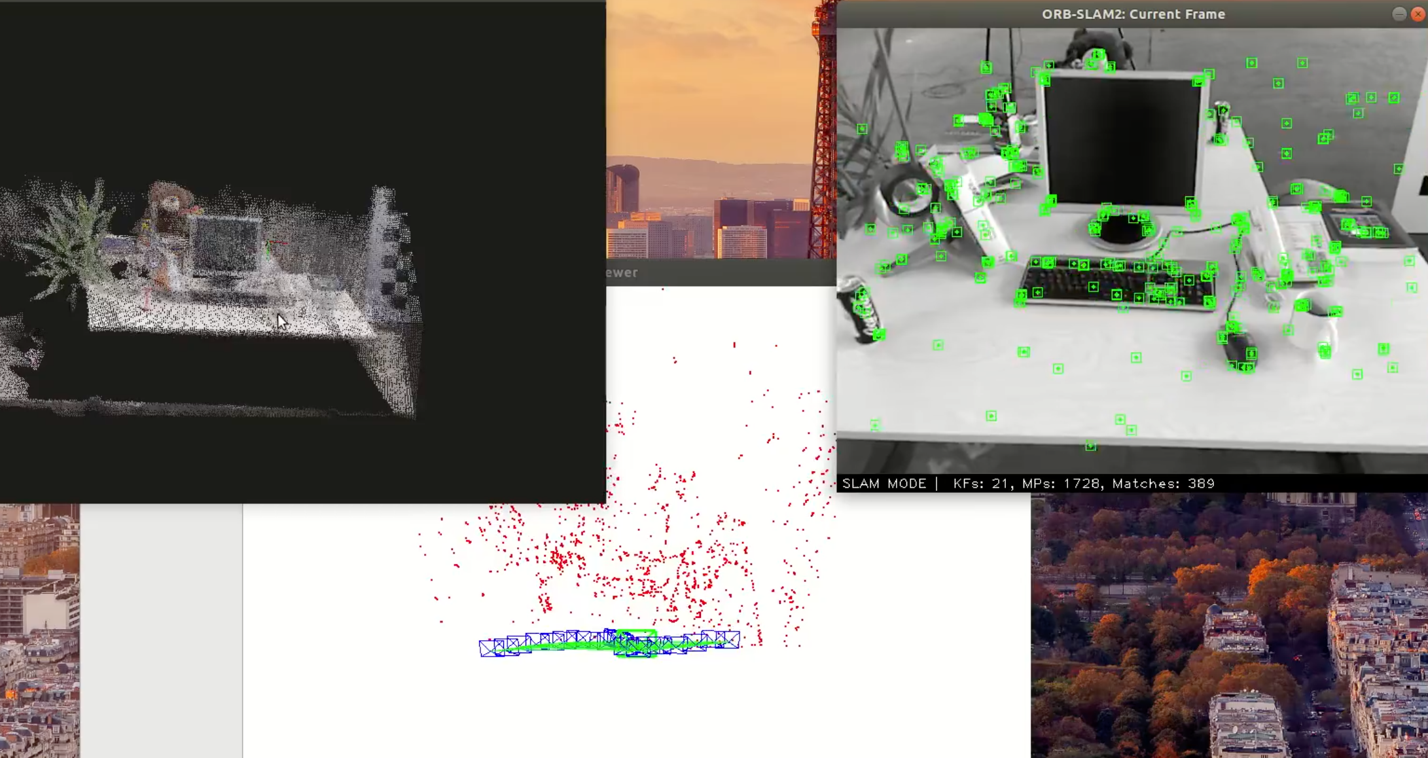
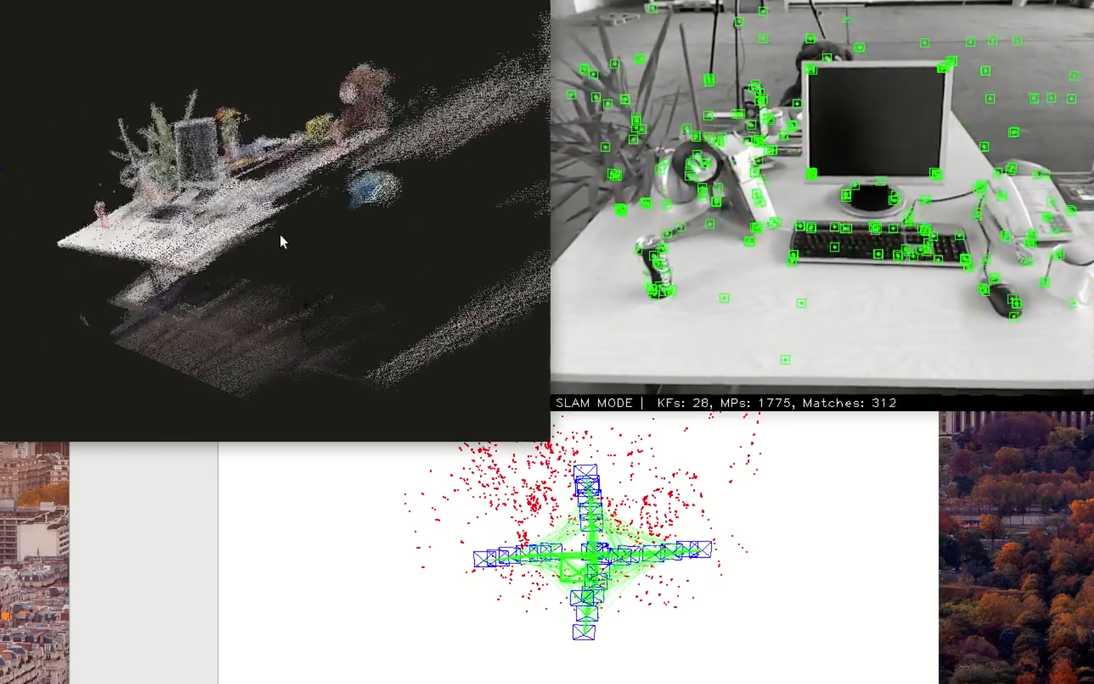
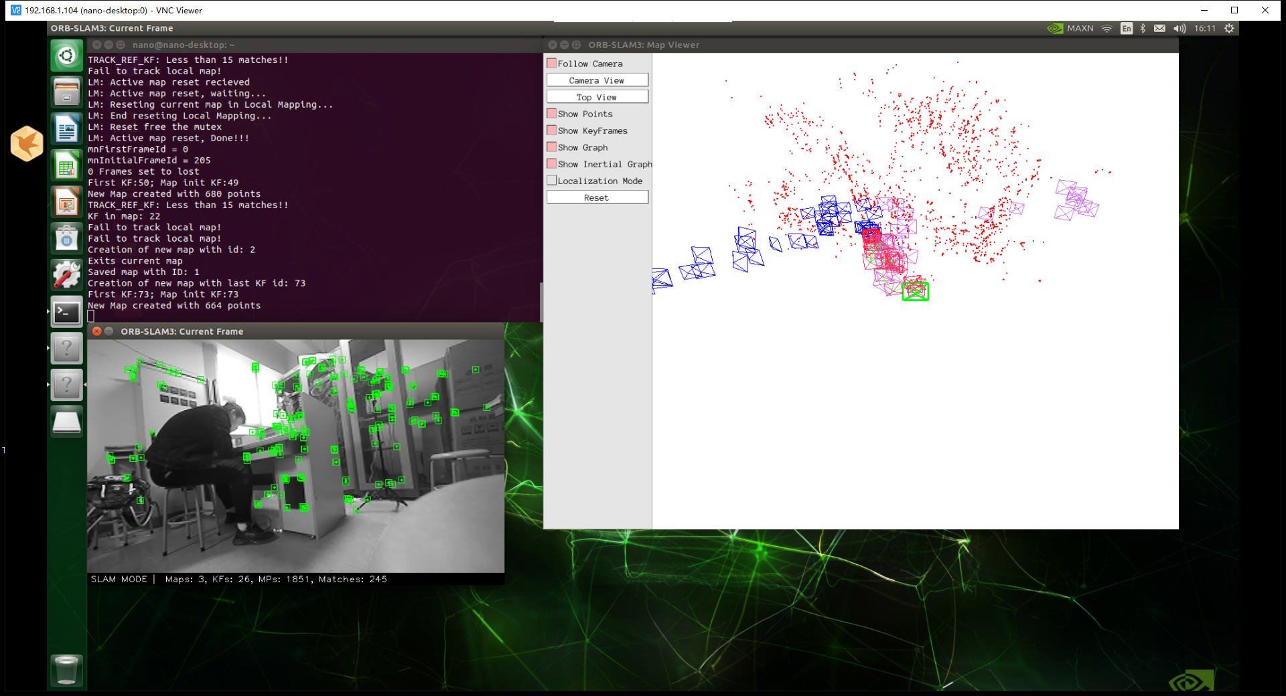
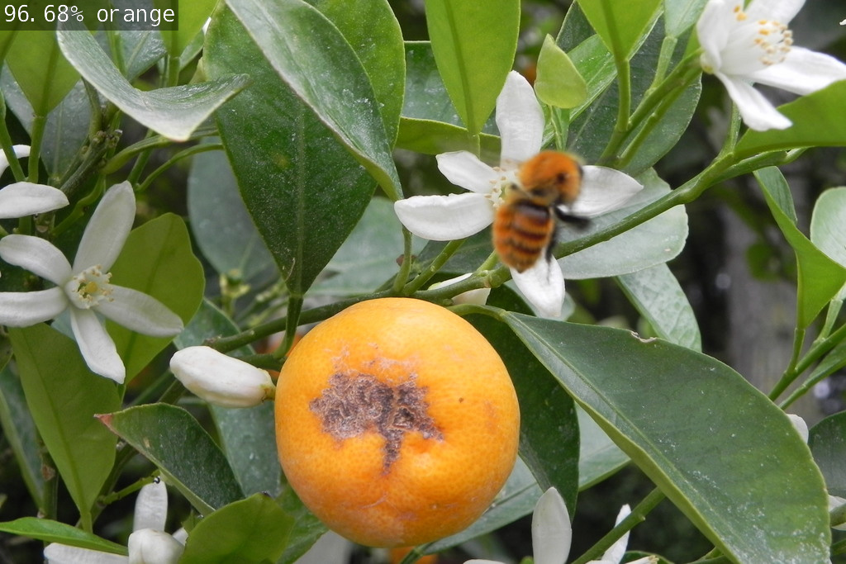
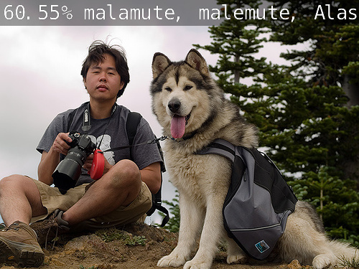
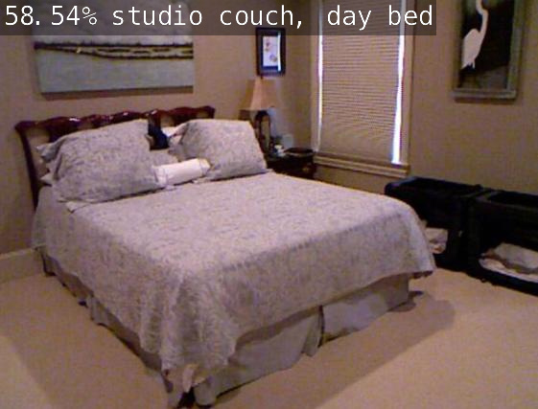
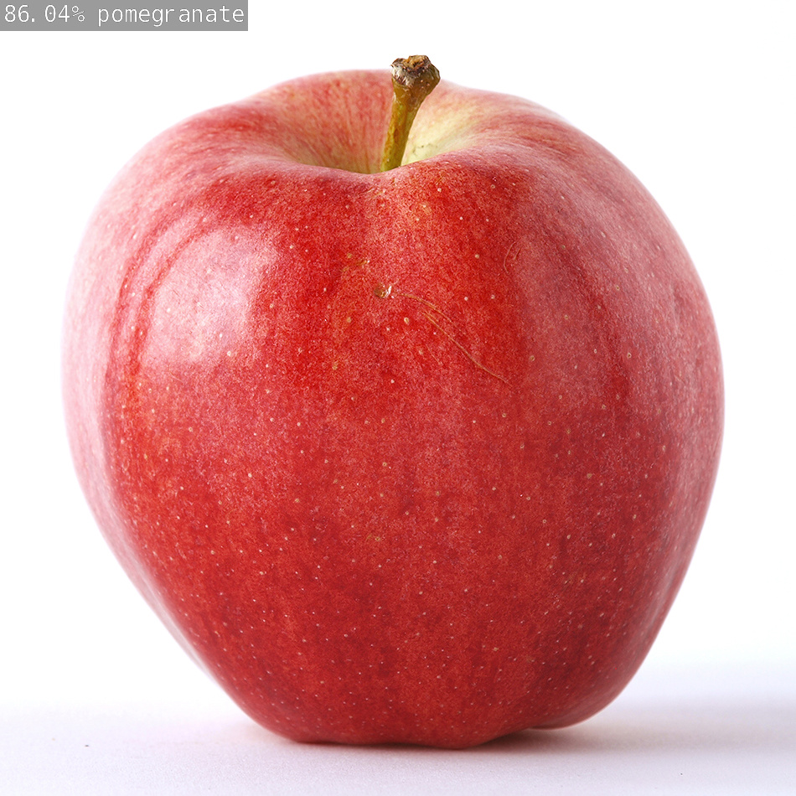
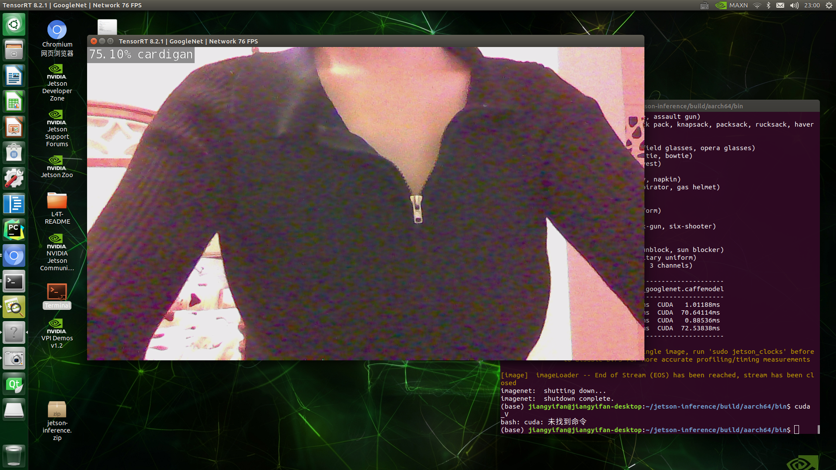
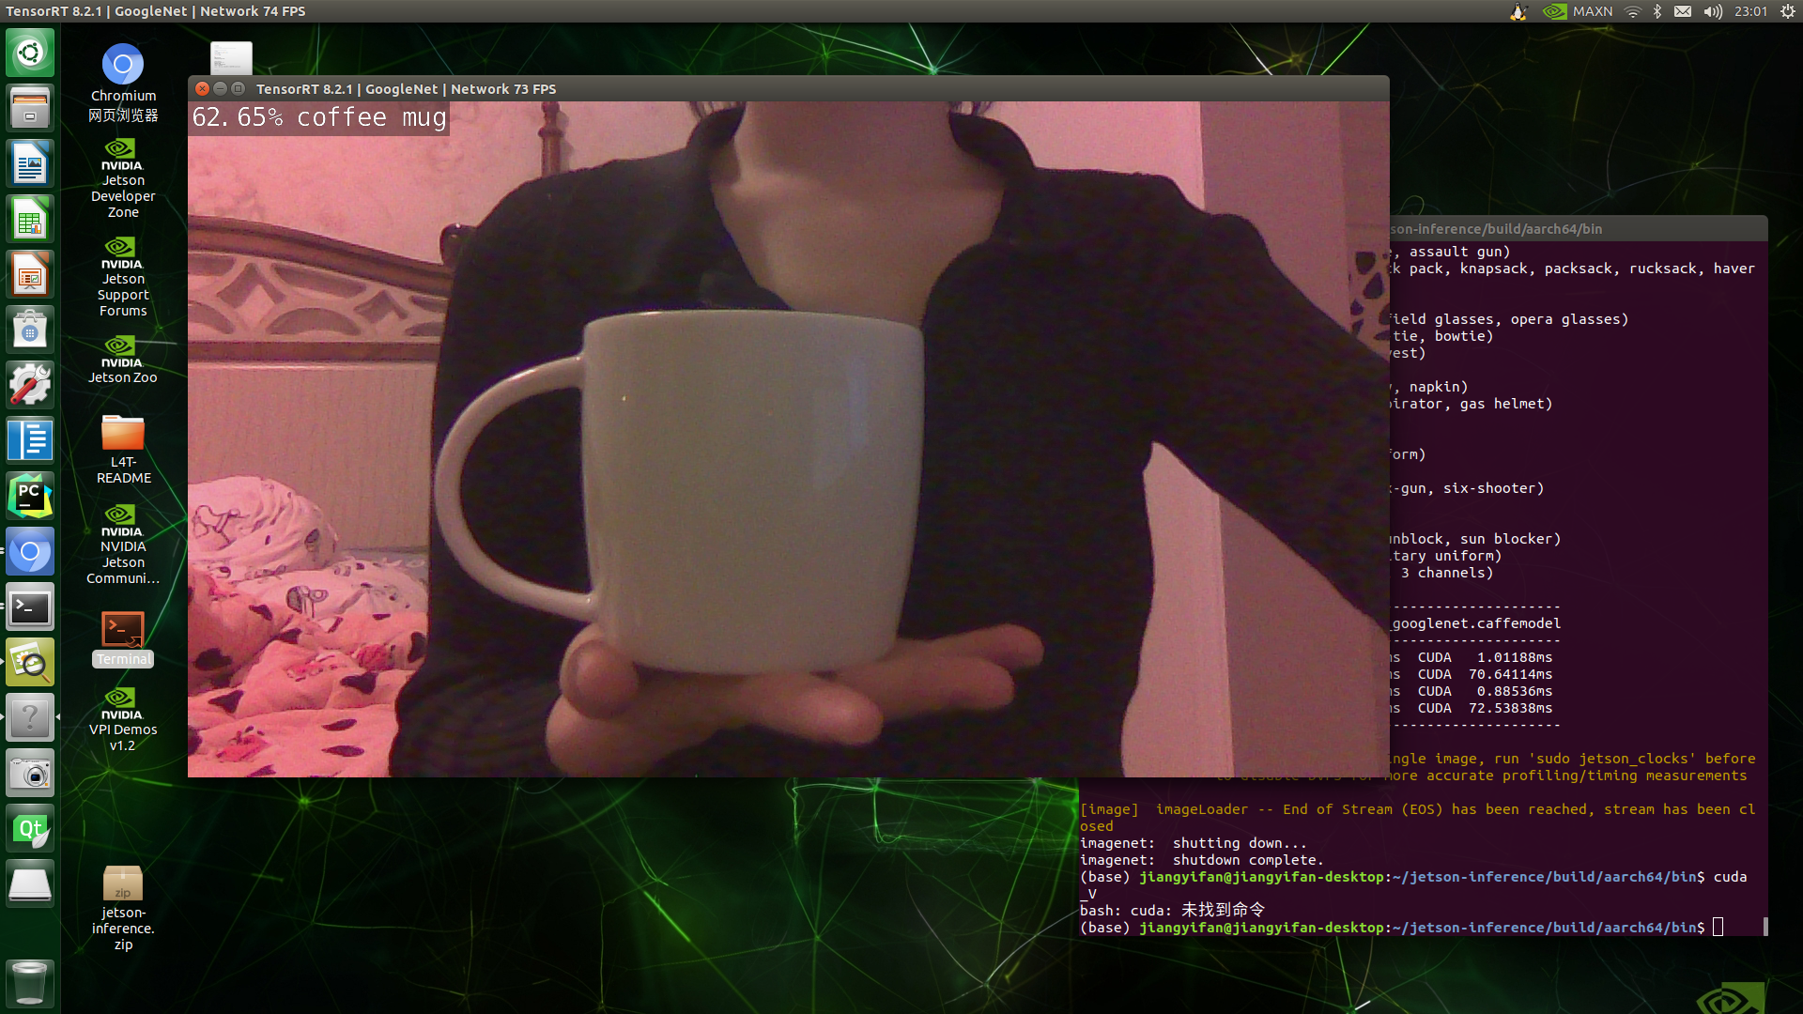
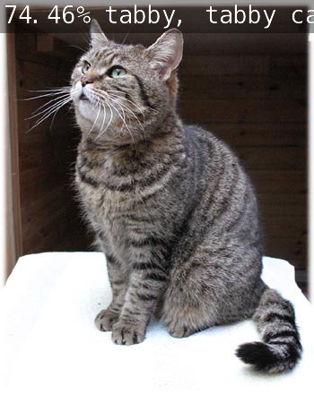
5. Continue

Slide 9
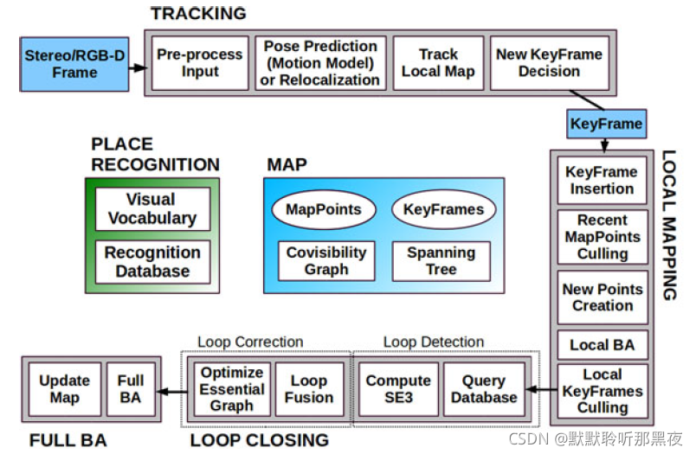
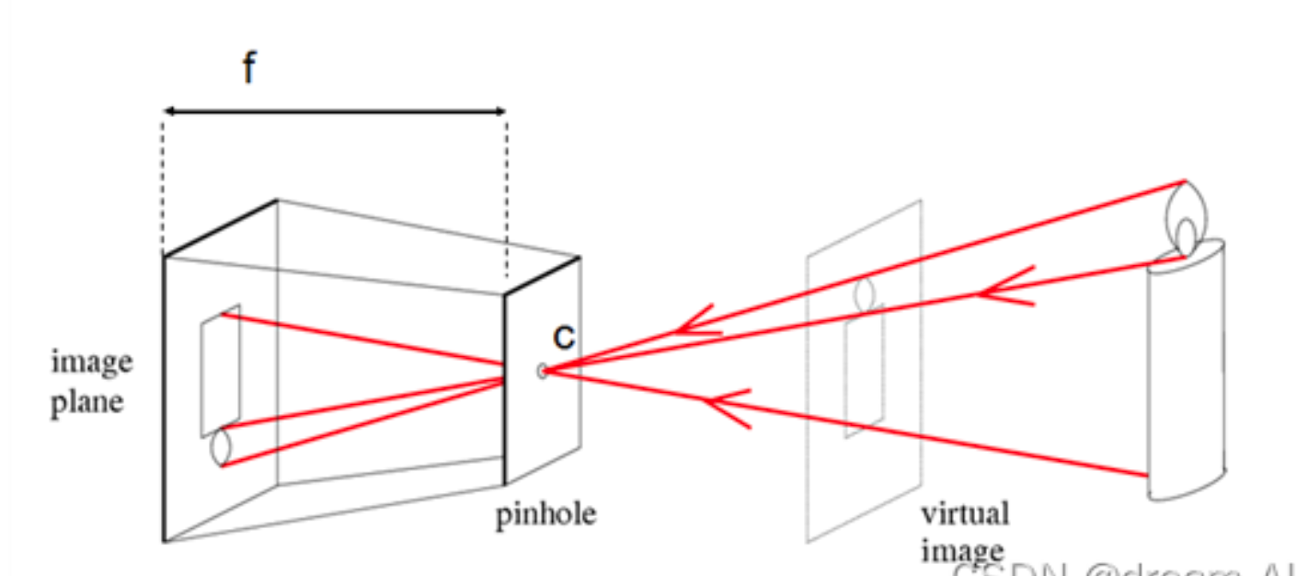
6. Discussion
Monocular
pinhole model
Binocular
orb-slam2

Slide 10
7. Future Works
The recognition accuracy needs to be improved
Further refinement of semantic segmentation
Improve the distance measure algorithm

Slide 11
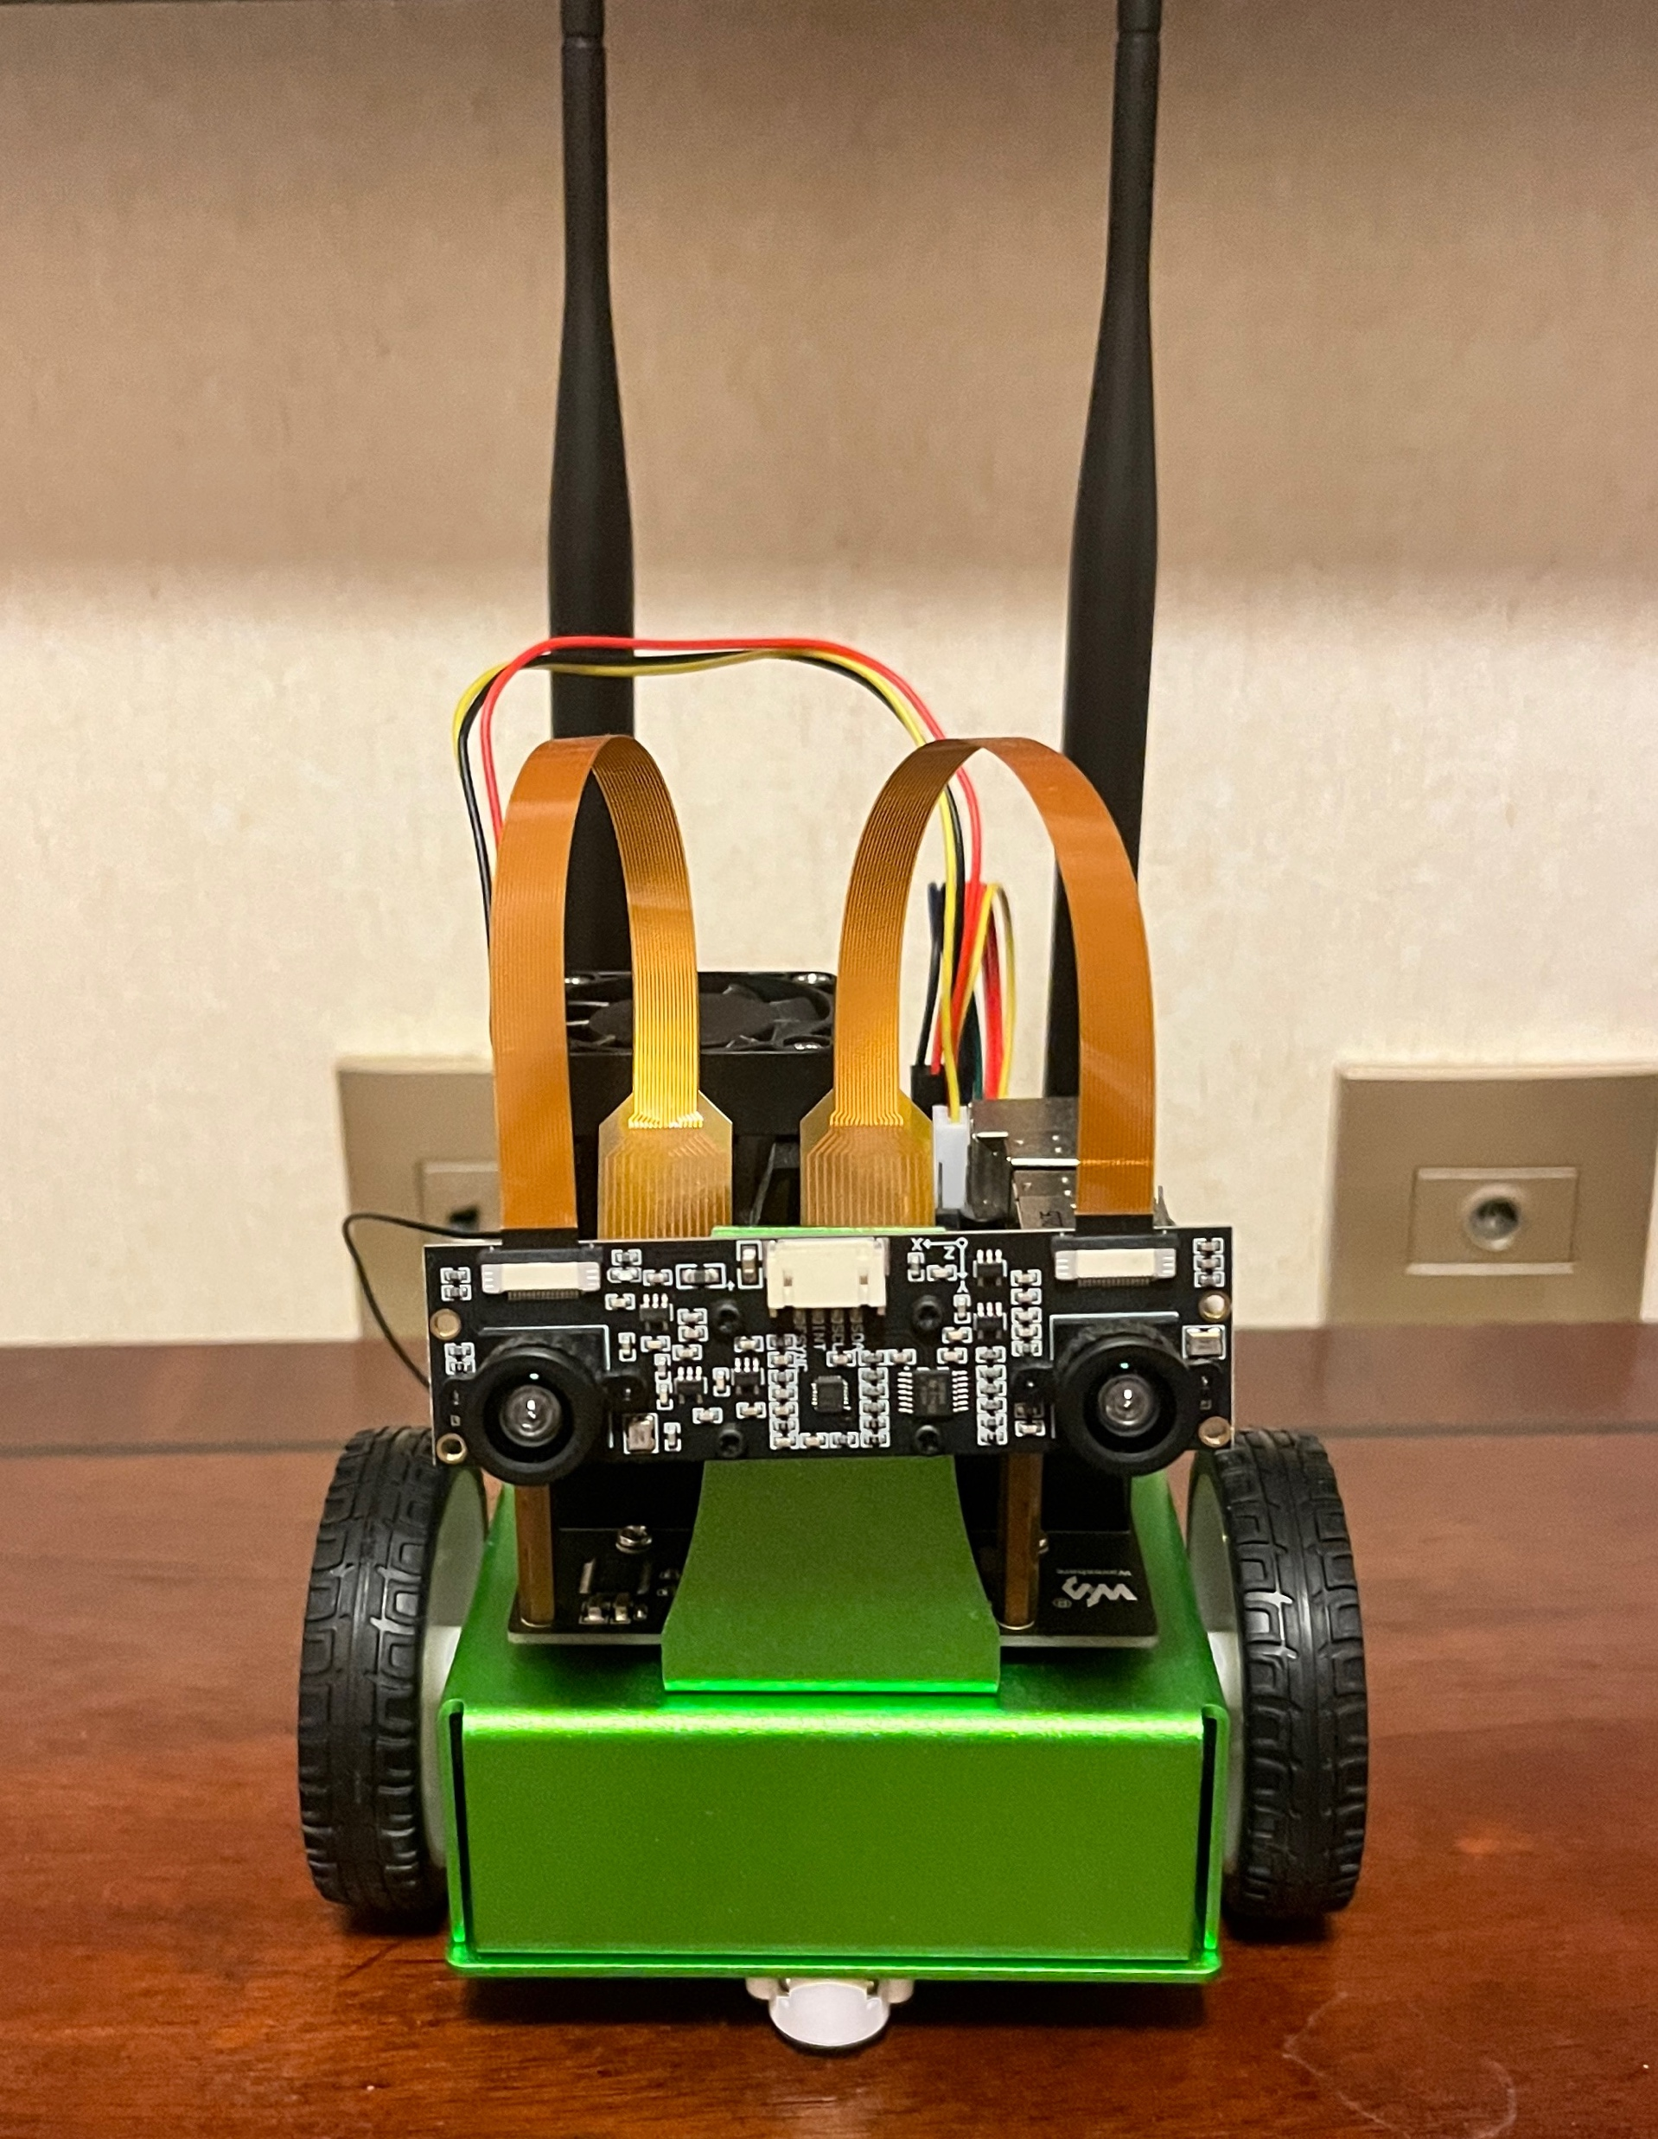
8. Conclusion
Embedded System：
Jetson nano
CNN and DNN
Binocular
image capture
object detection
distance ranging
User interface
distance and result
Efficiency
accuracy more than 90%

Slide 12
Thank You
Question?

